Slide 1

Pleasing God in
John 4: 22-24
Notes:
Will Gossett ~ January 25, 2025 (AM)

Slide 2
John 4: 22-24 NASB 1995
²² You worship what you do not know; we worship what we know, for salvation is from the Jews. ²³ But an hour is coming, and now is, when the true worshipers will worship the Father in spirit and truth;

Slide 3
John 4: 22-24 NASB 1995
for such people the Father seeks to be His worshipers.
²⁴ God is spirit, and those who worship Him must worship in spirit and truth.”

Slide 4
Romans 1:24-25 NASB 1995
²⁴ Therefore God gave them over in the lusts of their hearts to impurity, so that their bodies would be dishonored among them.

Slide 5
Romans 1:24-25 NASB 1995
²⁵ For they exchanged the truth of God for a lie, and worshiped and served the creature rather than the Creator, who is blessed forever. Amen.

Slide 6
Terms:
Worship – proskuneo (pros-koo-neh-o) to make obeisance do reverence to. It is used of an act of homage or reverence.

Slide 7
Terms:
Worshipper – proskunetes (pros-koo-nay-tace) an adorer.
Spirit – pneuma (pnyoo-mah) the rational soul.

Slide 8
Terms:
Truth – aletheia (al-ay-thi-a) truthfulness / truth not merely verbal, but sincerity and integrity of character.

Slide 9
Pleasing God in Worship
Items of Worship:
Praying
Singing
Giving
Communion
Preaching

Slide 10
item #1: Praying
Acts 1:13-14 NASB 1995
¹³ When they had entered the city, they went up to the upper room where they were staying;

Slide 11
Acts 1:13-14 NASB 1995
that is, Peter and John and James and Andrew, Philip and Thomas, Bartholomew and Matthew, James the son of Alphaeus, and Simon the Zealot, and Judas the son of James.

Slide 12
Acts 1:13-14 NASB 1995
¹⁴ These all with one mind were continually devoting themselves to prayer, along with the women, and Mary the mother of Jesus, and with His brothers.

Slide 13
Item #2: Singing
Ephesians 5:17-19 NASB 1995
¹⁷ So then do not be foolish, but understand what the will of the Lord is.

Slide 14
Ephesians 5:17-19 NASB 1995
¹⁸ And do not get drunk with wine, for that is dissipation, but be filled with the Spirit, ¹⁹ speaking to one another in psalms and hymns and spiritual songs,

Slide 15
Ephesians 5:17-19 NASB 1995
singing and making melody with your heart to the Lord;

Slide 16
Item #3: Giving
2 Corinthians 9:5-8 NASB 1995
⁵ So I thought it necessary to urge the brethren that they would go on ahead to you and arrange beforehand your previously promised bountiful gift,

Slide 17
2 Corinthians 9:5-8 NASB 1995
so that the same would be ready as a bountiful gift and not affected by covetousness.
⁶ Now this I say, he who sows sparingly will also reap sparingly,

Slide 18
2 Corinthians 9:5-8 NASB 1995
and he who sows bountifully will also reap bountifully.
⁷ Each one must do just as he has purposed in his heart, not grudgingly or under compulsion, for God loves a cheerful giver.

Slide 19
2 Corinthians 9:5-8 NASB 1995
⁸ And God is able to make all grace abound to you, so that always having all sufficiency in everything, you may have an abundance for every good deed;

Slide 20
Item #4: Communion
Matthew 26:26-28 NASB 1995
²⁶ While they were eating, Jesus took some bread, and after a blessing, He broke it and gave it to the disciples, and said, “Take, eat; this is My body.”

Slide 21
Matthew 26:26-28 NASB 1995
²⁷ And when He had taken a cup and given thanks, He gave it to them, saying, “Drink from it, all of you; ²⁸ for this is My blood of the covenant, which is poured out for many for forgiveness of sins.

Slide 22
Matthew 26:26-28 NASB 1995
²⁹ But I say to you, I will not drink of this fruit of the vine from now on until that day when I drink it new with you in My Father’s kingdom.”

Slide 23
Item #5: Preaching
Colossians 1:24-27 NASB 1995
²⁴ Now I rejoice in my sufferings for your sake, and in my flesh I do my share on behalf of His body, which is the church, in filling up what is lacking in Christ’s afflictions. afflictions.

Slide 24
Colossians 1:24-27 NASB 1995
²⁵ Of this church I was made a minister according to the stewardship from God bestowed on me for your benefit, so that I might fully carry out the preaching of the word of God,

Slide 25
Colossians 1:24-27 NASB 1995
²⁶ that is, the mystery which has been hidden from the past ages and generations, but has now been manifested to His saints,

Slide 26
Romans 12:1-2 NASB 1995
¹ Therefore I urge you, brethren, by the mercies of God, to present your bodies a living and holy sacrifice, acceptable to God, which is your spiritual service of worship.

Slide 27
Romans 12:1-2 NASB 1995
² And do not be conformed to this world, but be transformed by the renewing of your mind, so that you may prove what the will of God is, that which is good and acceptable and perfect.

Slide 28
If we’re not presenting our bodies as a living sacrifice, then we’ve missed the spiritual service of worship, thereby not worshipping in Spirit and in truth.

Slide 29
1 Peter 2:21-24 NASB 1995
²¹ For you have been called for this purpose, since Christ also suffered for you, leaving you an example for you to follow in His steps, ²² who committed no sin, nor was any deceit found in His mouth;

Slide 30
1 Peter 2:21-24 NASB 1995
²³ and while being reviled, He did not revile in return; while suffering, He uttered no threats, but kept entrusting Himself to Him who judges righteously;

Slide 31
1 Peter 2:21-24 NASB 1995
²⁴ and He Himself bore our sins in His body on the cross, so that we might die to sin and live to righteousness; for by His wounds you were healed.

Slide 32
John 14:6 NASB 1995
Jesus said to him, “I am the way, and the truth, and the life; no one comes to the Father but through Me.

Slide 33
John 3:3-5 NASB 1995
³ Jesus answered and said to him, “Truly, truly, I say to you, unless one is born again he cannot see the kingdom of God.”

Slide 34
John 3:3-5 NASB 1995
⁴ Nicodemus said to Him, “How can a man be born when he is old? He cannot enter a second time into his mother’s womb and be born, can he?”

Slide 35
John 3:3-5 NASB 1995
⁵ Jesus answered, “Truly, truly, I say to you, unless one is born of water and the Spirit he cannot enter into the kingdom of God.

Slide 36
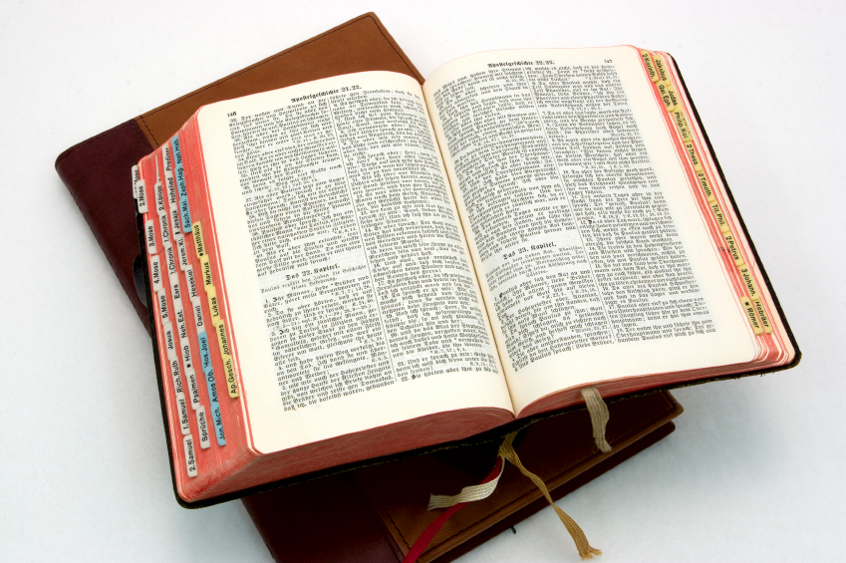
Hear: Romans 10:17
So then faith cometh by hearing, and hearing by the word of God.

Slide 37
Believe: Hebrews 11:6
But without faith it is impossible to please him: for he that cometh to God must believe that he is, and that he is a rewarder of them that diligently seek him.

Slide 38
Repent: Luke 13:3
I tell you, Nay: but, except ye repent, ye shall all likewise perish.

Slide 39
Confess: Matthew 10:32-33
32 Whosoever therefore shall confess me before men, him will I confess also before my Father which is in heaven.
33 But whosoever shall deny me before men, him will I also deny before my Father which is in heaven.

Slide 40
Baptize: Acts 22:16
And now why tarriest thou? arise, and be baptized, and wash away thy sins, calling on the name of the Lord.

